Slide 1
Circuit and Packet switching
MODULE 2

Slide 2
Overview
Switched Communications Networks:
Circuit Switching
Packet Switching
Comparison of Circuit Switching and Packet Switching
Implementing Network Software, Networking
Parameters(Transmission Impairment, Data Rate and Performance)

Slide 3
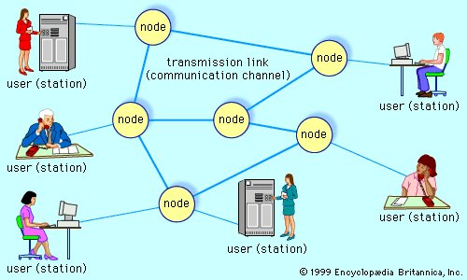
Telecommunications network, electronic system of links and switches, and the controls that govern their operation, that allows for data transfer and exchange among multiple users

Slide 4
When several users of telecommunications media wish to communicate with one another, they must be organized into some form of network.
In theory, each user can be given a direct point-to-point link to all the other users in what is known as a fully connected topology (telephone), but in practice this technique is impractical and expensive—especially for a large and dispersed network.
Method is inefficient, since most of the links will be idle at any given time.
Modern telecommunications networks avoid these issues by establishing a linked network of switches, or nodes, such that each user is connected to one of the nodes. Each link in such a network is called a communications channel. Wire, fibre-optic cable, and radio waves may be used for different communications channels.

Slide 5
Types of networks
Switched communications network
Broadcast network
Network access
Scheduled access
Random access
Carrier sense multiple access

Slide 6
Switched communications network
A switched communications network transfers data from source to destination through a series of network nodes.
Switching can be done in one of two ways. In a circuit-switched network, and a packet-switched network

Slide 7
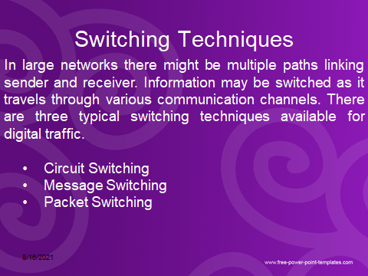
Switched Communications Networks

Slide 8
Circuit Switching
Circuit switching is a technique that directly connects the sender and the receiver in an unbroken path.
Telephone switching equipment, for example, establishes a path that connects the caller's telephone to the receiver's telephone by making a physical connection.
With this type of switching technique, once a connection is established, a dedicated path exists between both ends until the connection is terminated.
Routing decisions must be made when the circuit is first established, but there are no decisions made after that time.

Slide 9
Circuit switching
Advantages:
The communication channel (once established) is dedicated.
Disadvantages:
Possible long wait to establish a connection, (10 sec, more on long- distance or international calls.) during which no data can be transmitted.
More expensive than any other switching techniques, because a dedicated path is required for each connection. Inefficient use of the communication channel, because the channel is not used when the connected systems are not using it.

Slide 10
Message Switching
There is no need to establish a dedicated path between two stations.
When a station sends a message, the destination address is appended to the message.
The message is then transmitted through the network, in its entirety, from node to node.
Each node receives the entire message, stores it in its entirety on disk, and then transmits the message to the next node.
This type of network is called a store-and-forward network.

Slide 11
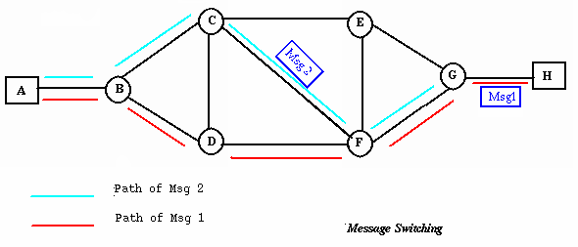
Message Switching
A message-switching node is typically a general-purpose computer.
The device needs sufficient secondary-storage capacity to store the incoming messages, which could be long.
A time delay is introduced using this type of scheme due to store- and-forward time, plus the time required to find the next node in the transmission path.

Slide 12
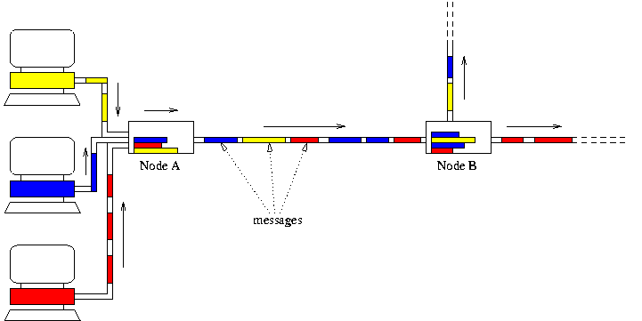
Message Switching

Slide 13
Message Switching
Advantages:
Channel efficiency can be greater compared to circuit- switched systems, because more devices are sharing the channel.
Traffic congestion can be reduced, because messages may be temporarily stored in route.
Message priorities can be established due to store-and-forward technique.
Message broadcasting can be achieved with the use of broadcast address appended in the message.

Slide 14
Message Switching
Disadvantages:
Message switching is not compatible with interactive applications.
Store-and-forward devices are expensive, because they must have large disks to hold potentially long messages.

Slide 15
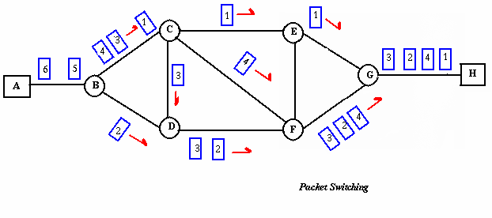
Packet Switching
Packet switching can be seen as a solution that tries to combine the advantages of message and circuit switching and to minimize the disadvantages of both.
The methods of packet switching: Datagram and virtual circuit.

Slide 16
Packet Switching
In both packet switching methods, a message is broken into small parts, called packets.
Each packet is tagged with appropriate source and destination addresses.
Since packets have a strictly defined maximum length, they can be stored in main memory instead of disk, therefore access delay and cost are minimized.
Also the transmission speeds, between nodes, are optimized.
With current technology, packets are generally accepted onto the network on a first-come, first-served FIFO basis. If the network becomes overloaded, packets are delayed or discarded (``dropped'').

Slide 17
Packet size
The size of the packet can vary from 180 bits, the size for the Data kit® virtual circuit switch designed by Bell Labs for communications and business applications.
To 1,024 or 2,048 bits for the 1PSS® switch, also designed by Bell Labs for public data networking; to 53 bytes for ATM switching, such as Lucent Technologies' packet switches.

Slide 18
Packet switching
The analog signal from your phone is converted into a digital data stream. That series of digital bits is then divided into relatively tiny clusters of bits, called packets. Each packet has at its beginning the digital address -- a long number -- to which it is being sent. The system blasts out all those tiny packets, as fast as it can, and they travel across the nation's digital backbone systems to their destination: the telephone, or rather the telephone system, of the person you're calling.
They do not necessarily travel together; they do not travel sequentially. They don't even all travel via the same route. But eventually they arrive at the right point -- that digital address added to the front of each string of digital data -- and at their destination are reassembled into the correct order, then converted to analog form, so your friend can understand what you're saying.

Slide 19
Packet Switching: Datagram
Datagram packet switching is similar to message switching in that each packet is a self-contained unit with complete addressing information attached.
This fact allows packets to take a variety of possible paths through the network.
So the packets, each with the same destination address, do not follow the same route, and they may arrive out of sequence at the exit point node (or the destination).
Reordering is done at the destination point based on the sequence number of the packets.
It is possible for a packet to be destroyed if one of the nodes on its way is crashed momentarily. Thus all its queued packets may be lost.

Slide 20
Packet Switching: Virtual Circuit
In the virtual circuit approach, a preplanned route is established
before any data packets are sent.
A logical connection is established when
a sender send a "call request packet" to the receiver and the receiver send back an acknowledge packet "call accepted packet" to the sender if the receiver agrees on conversational parameters.
The conversational parameters can be maximum packet sizes, path to be taken, and other variables necessary to establish and maintain the conversation.
Virtual circuits imply acknowledgements, flow control, and error control, so virtual circuits are reliable.
That is, they have the capability to inform upper-protocol layers if a transmission problem occurs.

Slide 21
Packet Switching:Virtual Circuit
In virtual circuit, the route between stations does not mean that this is a dedicated path, as in circuit switching.
A packet is still buffered at each node and queued for output over a line.
The difference between virtual circuit and datagram approaches:
With virtual circuit, the node does not need to make a routing decision for each packet.
It is made only once for all packets using that virtual circuit.

Slide 22
Packet Switching: Virtual Circuit
VC's offer guarantees that
the packets sent arrive in the order sent
with no duplicates or omissions
with no errors (with high probability)
regardless of how they are implemented internally.

Slide 23
Advantages of packet switching
Advantages:
Packet switching is cost effective, because switching devices do not need massive amount of secondary storage.
Packet switching offers improved delay characteristics, because there are no long messages in the queue(max packet size is fixed).
Packet can be rerouted if there is any problem, such as, busy or disabled links.
The advantage of packet switching is that many network users can share the same channel at the same time. Packet switching can maximize link efficiency by making optimal use of link bandwidth.

Slide 24
Disadvantages of packet switching
Disadvantages:
Protocols for packet switching are typically more complex.
It can add some initial costs in implementation.
If packet is lost, sender needs to retransmit the data.
Another disadvantage is that packet-switched systems still
can’t deliver the same quality as dedicated circuits in applications requiring very little delay - like voice
conversations or moving images.

Slide 25
Implementing Network Software
1 Introduction
2 Sockets
3 Reading and Writing
4 Writing the Server side
5 The Knock Knock Server
6 The Knock Knock Protocol
7 The Knock Knock Client
8 Running the Programs
9 Supporting Multiple Clients

Slide 26
Implementing Network Software
In Client/Server applications, the server provides services and the client consume these services. The communication between client and server should be reliable what means that no data can be dropped, it just must arrive in the same order that was sent.
TCP provides a reliable one for this purpose. It is called point to point communication and it creates a channel between client and server where the connection starts and ends in a socket.

Slide 27
Implementing Network Software - Sockets
A socket is one end point of two way communication link between programs running on the network. In java, Sockets are classes that represent the connection between client (class Socket) and server (class ServerSocket). A socket is bound to a port number so that the TCP layer can identify the application that data is destined to be sent to.
An endpoint is a combination of an IP address and a port number. Every TCP connection can be uniquely identified by its endpoints. That way you can have multiple connections between your host and the server.

Slide 28
Sockets
End-point of inter process communication
Provides an interface to send data to/from the network through a port
Exists on either side of connection
What exactly creates a Socket?
<IP address, Port #> tuple
What makes a connection?
{Source<IP address, Port #>, Destination <IP address, Port #>}
i.e. source socket – destination socket pair uniquely identifies a connection

Slide 29
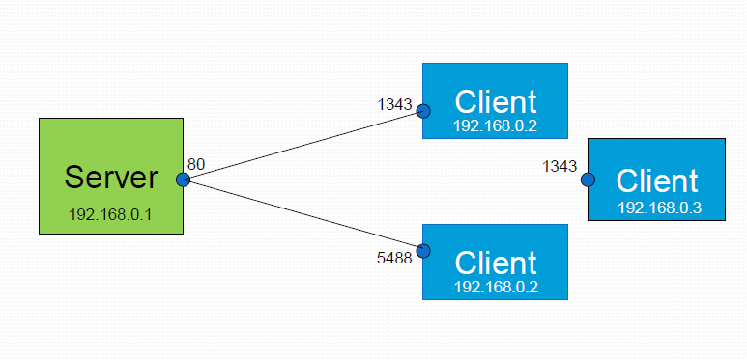
Example

Slide 30
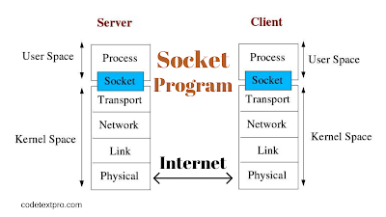
Socket Programming in Networking

Slide 31
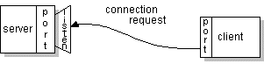
Implementing Network Software
Sockets

Slide 32
TYPES
Two essential types of sockets:
Stream Sockets
– Connection oriented
– Rely on TCP to provide reliable two way connected communication
Datagram Sockets
– Rely on UDP
– Connection is unreliable

Slide 33
Use of Sockets
Connection–based sockets communicate client-server: the server waits for a connection from the client
Connectionless sockets are peer-to peer: each process is symmetric.

Slide 34
Sockets : Client-Server application
Algorithm for TCP client
– Find the IP address and port number of server
– Create a TCP socket
– Connect the socket to server (Server must be up and listening for new requests)
– Send/receive data with server using the socket
– Close the connection

Slide 35
Sockets : Client-Server application
Algorithm for TCP SERVER
– Find the port number of server
– Create a TCP server socket
– Bind the server socket to server Port number (this is the port to which clients will connect)
– Accept a new connection from client
– Send/receive data with client using the client socket
– Close the connection with client

Slide 36
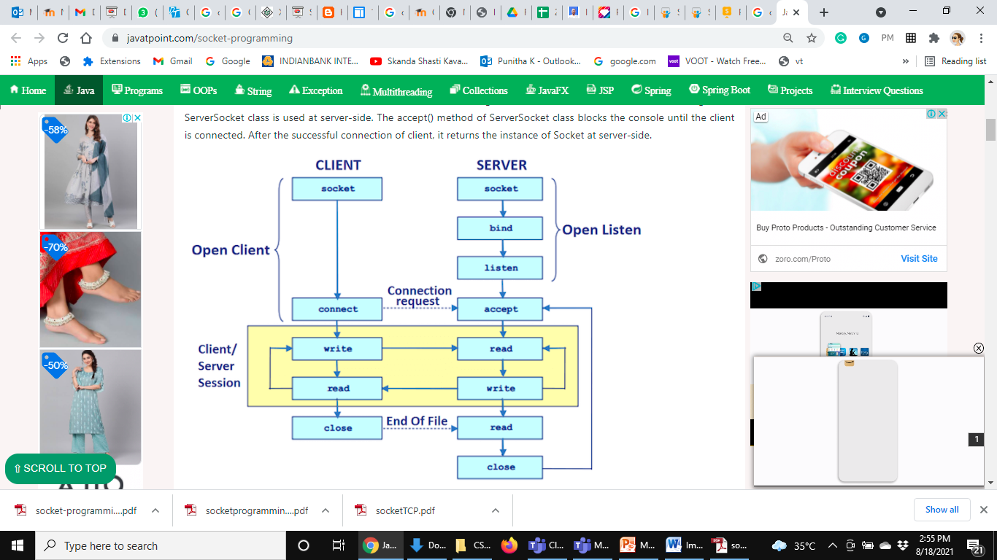
Sockets : Client-Server application

Slide 37
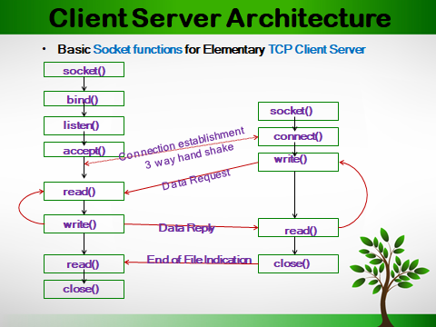

Slide 38
Feature | TCP | UDP
Connection status | Requires an established connection to transmit data (connection should be closed once transmission is complete) | Connectionless protocol with no requirements for opening, maintaining, or terminating a connection
Data sequencing | Able to sequence | Unable to sequence
Guaranteed delivery | Can guarantee delivery of data to the destination router | Cannot guarantee delivery of data to the destination
Retransmission of data | Retransmission of lost packets is possible | No retransmission of lost packets

Slide 39
Feature | TCP | UDP
Error checking | Extensive error checking and acknowledgment of data | Basic error checking mechanism using checksums
Method of transfer | Data is read as a byte stream; messages are transmitted to segment boundaries | UDP packets with defined boundaries; sent individually and checked for integrity on arrival
Speed | Slower than UDP | Faster than TCP
Broadcasting | Does not support Broadcasting | Does support Broadcasting
Optimal use | Used by HTTPS, HTTP, SMTP, POP, FTP, etc | Video conferencing streaming, DNS, VoIP, etc

Slide 40
Noisy data
Noisy data: data with a large amount of additional meaningless information in it called noise.
Noisy data means corrupted data. It also includes any data that cannot be understood and interpreted correctly by machines, such as unstructured text.
Noisy data can adversely affect the results of any data analysis and skew conclusions if not handled properly. Statistical analysis is sometimes used to weed the noise out of noisy data

Slide 41
Sources of noise
Differences in real-world measured data from the true values come about from by multiple factors affecting the measurement.
Random noise (white noise) in a signal is measured as the Signal-to-Noise Ratio. Random noise is an unavoidable problem. It affects the data collection and data preparation processes, where errors commonly occur.

Slide 42
Signals travel through transmission media, which are not perfect. The imperfection causes signal impairment.
This means that the signal at the beginning of the medium is not the same as the signal at the end of the medium. What is sent is not what is received.
Three causes of impairment are attenuation, distortion, and noise

Slide 43
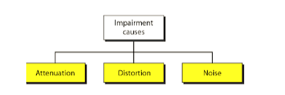
Impairments

Slide 44
Attenuation
Means loss of energy -> weaker signal
When a signal travels through a medium it loses energy overcoming the resistance of the medium.
That is why a wire carrying electric signals gets warm, if not hot, after a while. Some of the electrical energy in the signal is converted to heat.
Amplifiers are used to compensate for this loss of energy by amplifying the signal.

Slide 45
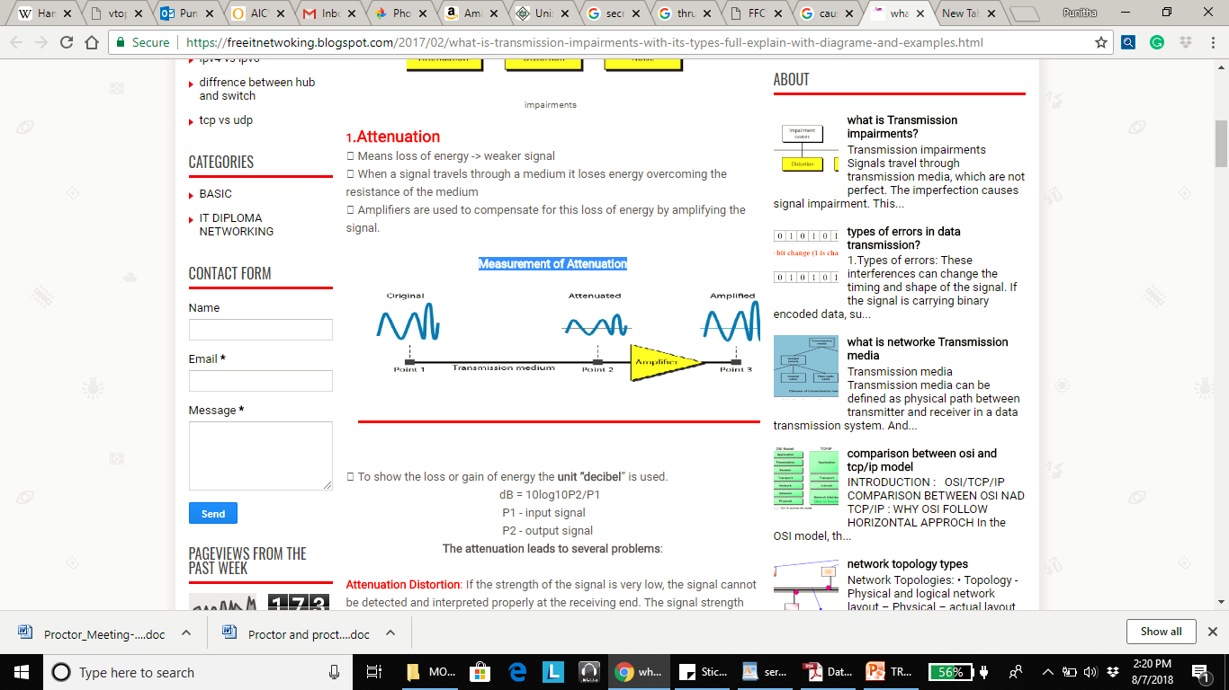
Measurement of Attenuation

Slide 46
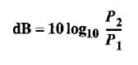
Decibel
To show that a signal has lost or gained strength, engineers use the unit of the decibel.
The decibel (dB) measures the relative strengths of two signals or one signal at two different points. Note that the decibel is negative if a signal is attenuated and positive if a signal is amplified.
Variables P1 and P2 are the powers of a signal at points 1 and 2, respectively. In this case, because power is proportional to the square of the voltage, the formula is dB = 20 log 10 (V2 / V1).

Slide 47
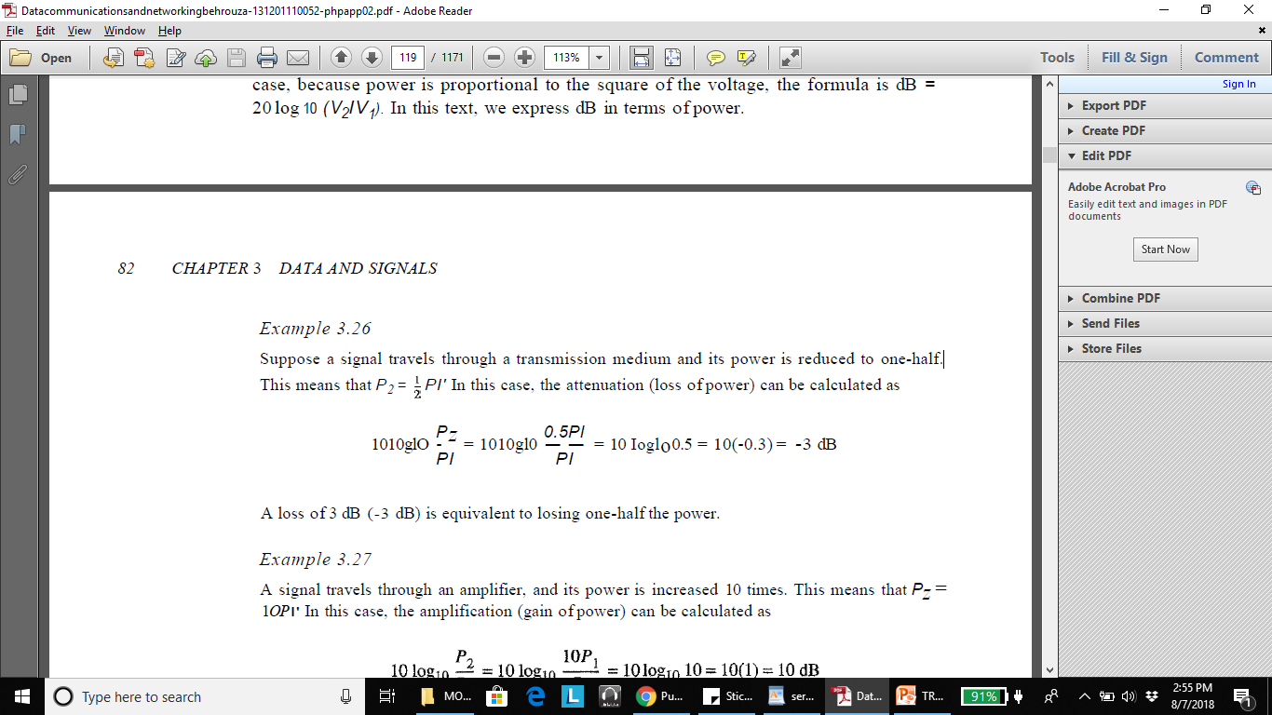
Example 1
Suppose a signal travels through a transmission medium and its power is reduced to one-half.
A loss of 3 dB (-3 dB) is equivalent to losing one-half the power.

Slide 48
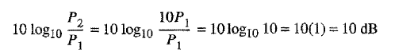
Example 2
A signal travels through an amplifier, and its power is increased 10 times. This means that Pz= 1OP1. In this case, the amplification (gain of power) can be calculated as

Slide 49
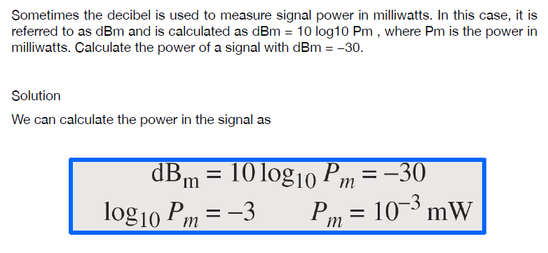
Example 3

Slide 50
Distortion
Distortion means that the signal changes its form or shape. Distortion can occur in a composite signal made of different frequencies. Each signal component has its own propagation speed (see the next section) through a medium and, therefore, its own delay in arriving at the final destination.
Differences in delay may create a difference in phase if the delay is not exactly the same as the period duration. In other words, signal components at the receiver have phases different from what they had at the sender.

Slide 51
Distortion
Distortion is known as the alternation of the original signal. This may happen due to the properties of the medium. There are many types of distortion such as amplitude distortion, harmonic distortion, and phase distortion.
For electromagnetic waves polarization distortions also occurs. When the distortion occurs, shape of the waveform is changed.
For example, amplitude distortion happens if all the parts of the signals are not equally amplified. This happens in wireless transmissions because the medium get changed by the time. The receivers should be able to identify these distortions.

Slide 52
Distortion

Slide 53
Distortion
Types:
Amplitude distortion
Delay / Phase Distortion
Frequency related distortion

Slide 54
Difference between attenuation and distortion
Although scaled down in amplitude, shape of waveform does not change in attenuation unlike in distortion.
Removal of the effects of attenuation is easier than a removing the effects distortion.
If the attenuation happens in different amounts for the different parts of the signal, it is a distortion.

Slide 55
Noise
The random and unpredicted electrical signal (coming from both internal or external portion of the system) which interfere the reception of actual required signal is called- noise.
Noise can be characterized by statistical parameter such as averaged/ squared noise, current/ voltage etc.
Noise is unwanted signals that are inserted somewhere between transmission and reception. Noise is the major limiting factor in communications system performance. Noise may be divided into four categories:
Thermal noise, Intermodulation noise, Cross talk, Impulse noise …

Slide 56
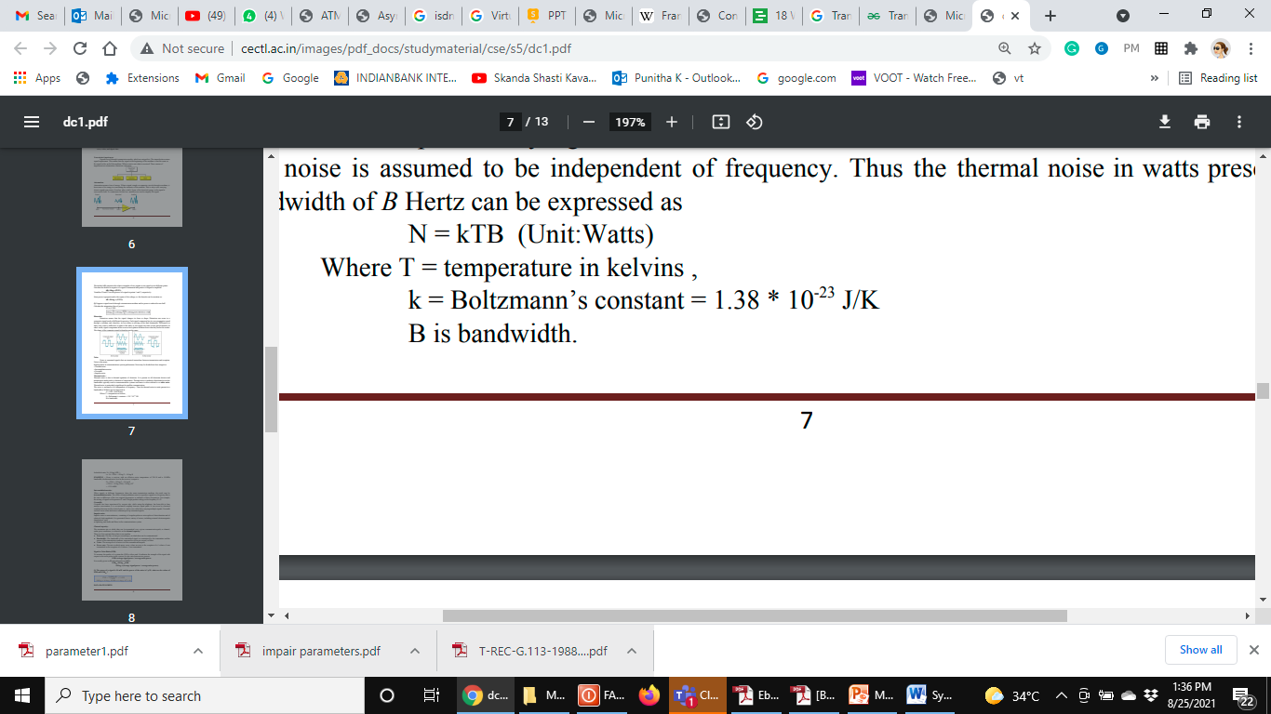
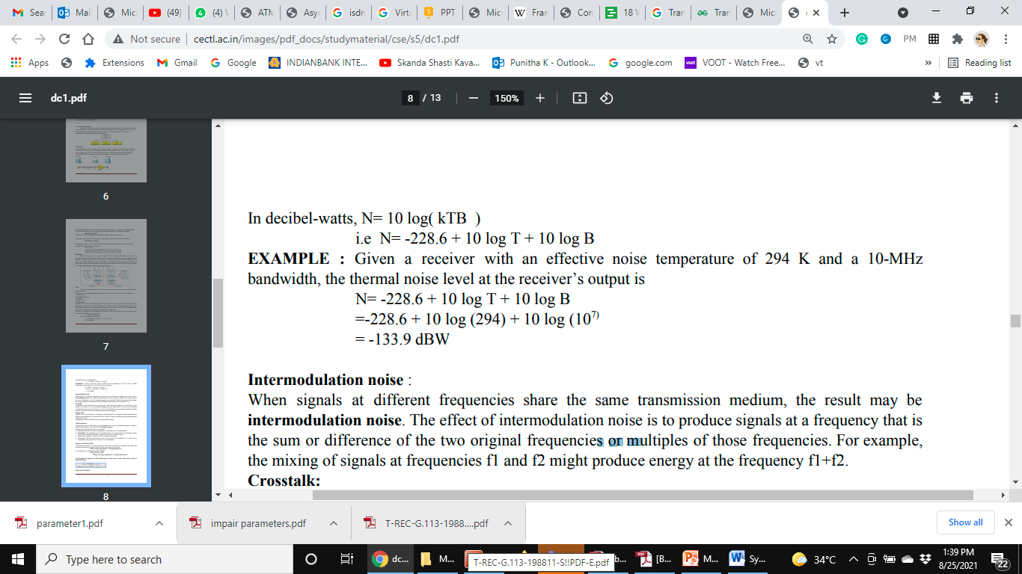
Thermal noise
Thermal noise in watts present in a bandwidth of B Hertz can be expressed as: N = kTB (Unit:Watts)
Where T = temperature in kelvins ,

Slide 57
Thermal noise
Thermal noise is due to thermal agitation of electrons. It is present in all electronic devices and transmission media and is a function of temperature.
Thermal noise is uniformly distributed across the bandwidths typically used in communications systems and hence is often referred to as white noise.
Thermal noise is particularly significant for satellite communication. The noise is assumed to be independent of frequency. Thus the thermal noise in watts present in a bandwidth of B Hertz can be expressed as

Slide 58
Intermodulation noise: When signals at different frequencies share the same transmission medium, the result may be intermodulation noise. The effect of intermodulation noise is to produce signals at a frequency that is the sum or difference of the two original frequencies or multiples of those frequencies. For example, the mixing of signals at frequencies f1 and f2 might produce energy at the frequency f1+f2.
Crosstalk: Crosstalk has been experienced by anyone who, while using the telephone, has been able to hear another conversation; it is an unwanted coupling between signal paths. It can occur by electrical coupling between nearby twisted pairs or, rarely coax cable lines carrying multiple signals. Crosstalk can also occur when microwave antennas pick up unwanted signals.

Slide 59
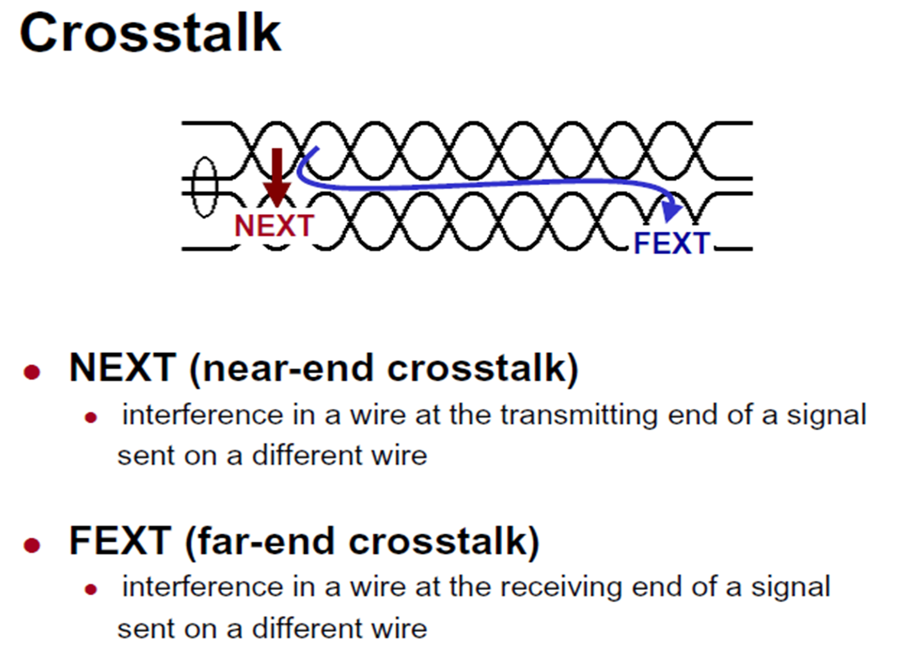

Slide 60
Impulse noise: Impulse noise is non continuous, consisting of irregular pulses or noise spikes of short duration and of relatively high amplitude. It is generated from a variety of causes, including external electromagnetic disturbances, such as lightning, and faults and flaws in the communications system.

Slide 61
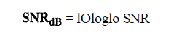
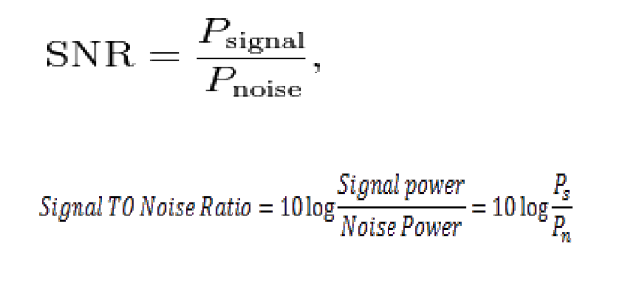
Signal-to-noise ratio (SNR)
SNR is the ratio of two powers, it is often described in decibel units, SNR_{dB}, defined as

Slide 62
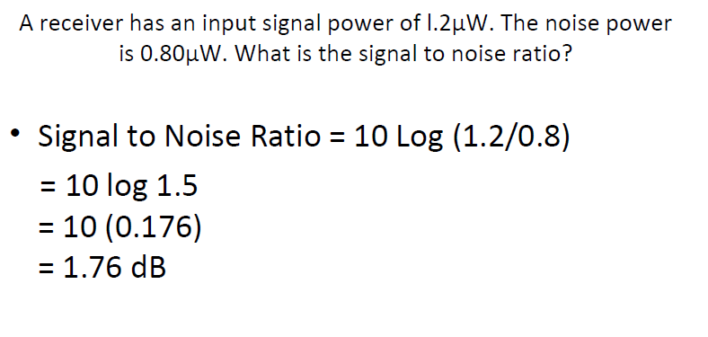

Slide 63
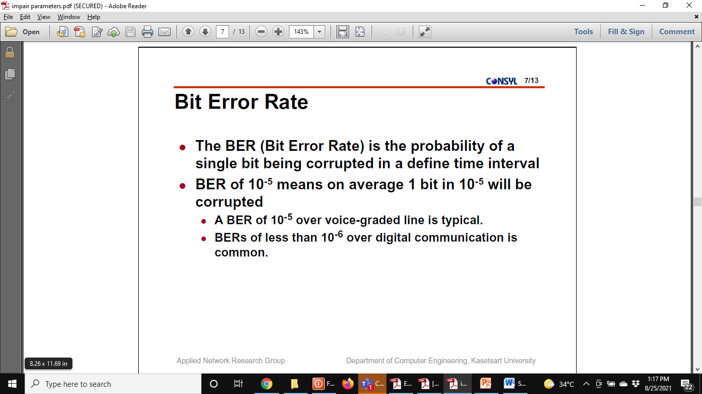
Bit error rate(BER)

Slide 64
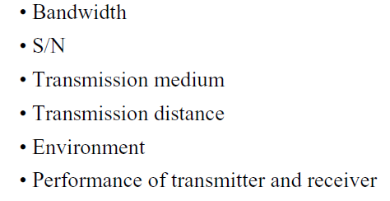
Bit error rate(BER)
Several factors that effect BER:

Slide 65
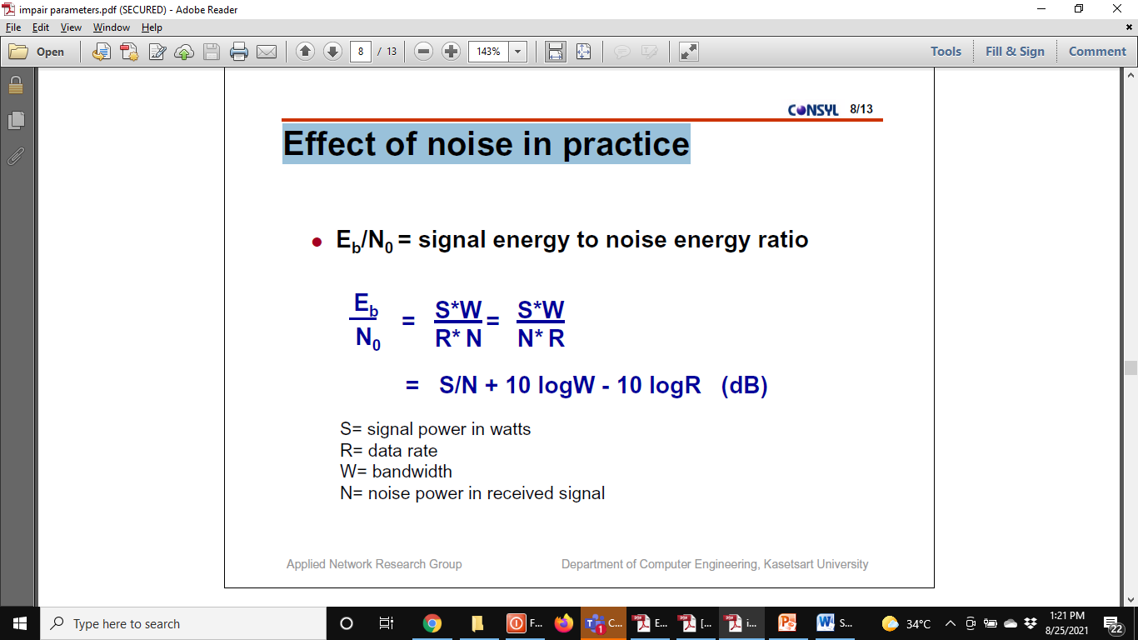
Effect of noise practice

Slide 66
Channel capacity
The maximum rate at which data can be transmitted over a given communication path, or channel, under given conditions, is referred to as the channel capacity.
There are four concepts that relate to one another
Data rate: The rate, in bits per second (bps), at which data can be communicated.
Bandwidth: The bandwidth of the transmitted signal as constrained by the transmitter and the nature of the transmission medium, expressed in cycles per second, or Hertz
Noise: The average level of noise over the communications path
Error rate: The rate at which errors occur, where an error is the reception of a 1 when a 0 was transmitted or the reception of a 0 when a 1 was transmitted.

Slide 67
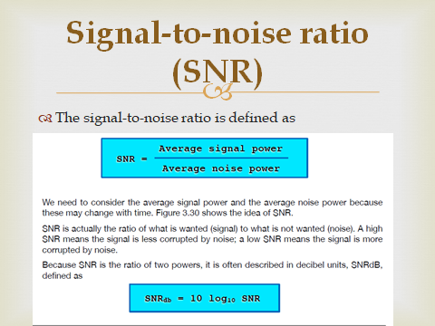

Slide 68
DATA RATE LIMITS
A very important consideration in data communications is how fast we can send data, in bits per second. over a channel.
Data rate depends on three factors:
1. The bandwidth available
2. The level of the signals we use
3. The quality of the channel (the level of noise)
Two theoretical formulas were developed to calculate the data rate: one by Nyquist for a noiseless channel. Another by Shannon for a noisy channel.

Slide 69
Nyquist Bandwidth
In noiseless environment, the limitation on data rate is simply the bandwidth of the signal. A formulation of this limitation, due to Nyquist, states that “ if the rate of signal transmission is 2B, then a signal with frequencies no greater than B is sufficient to carry the signal rate”.
Given a bandwidth of B, the highest signal rate that can be carried is 2B”. C = 2 x B x log2M
Where C is BitRate or capacity ,B is Bandwith ,M is number of levels.

Slide 70
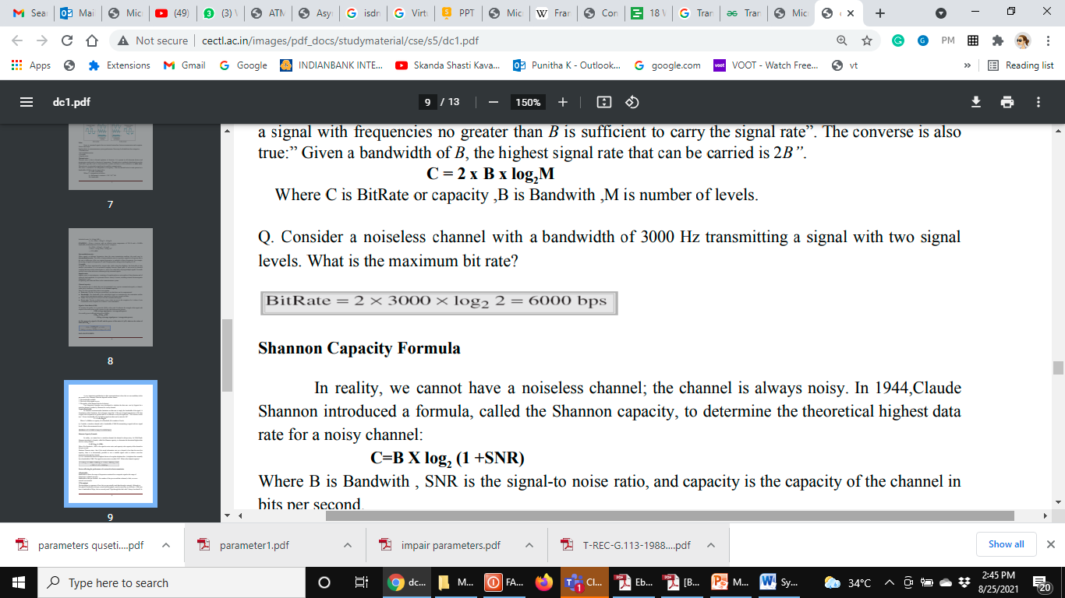
Nyquist Bandwidth
Consider a noiseless channel with a bandwidth of 3000 Hz transmitting a signal with two signal levels. What is the maximum bit rate?

Slide 71
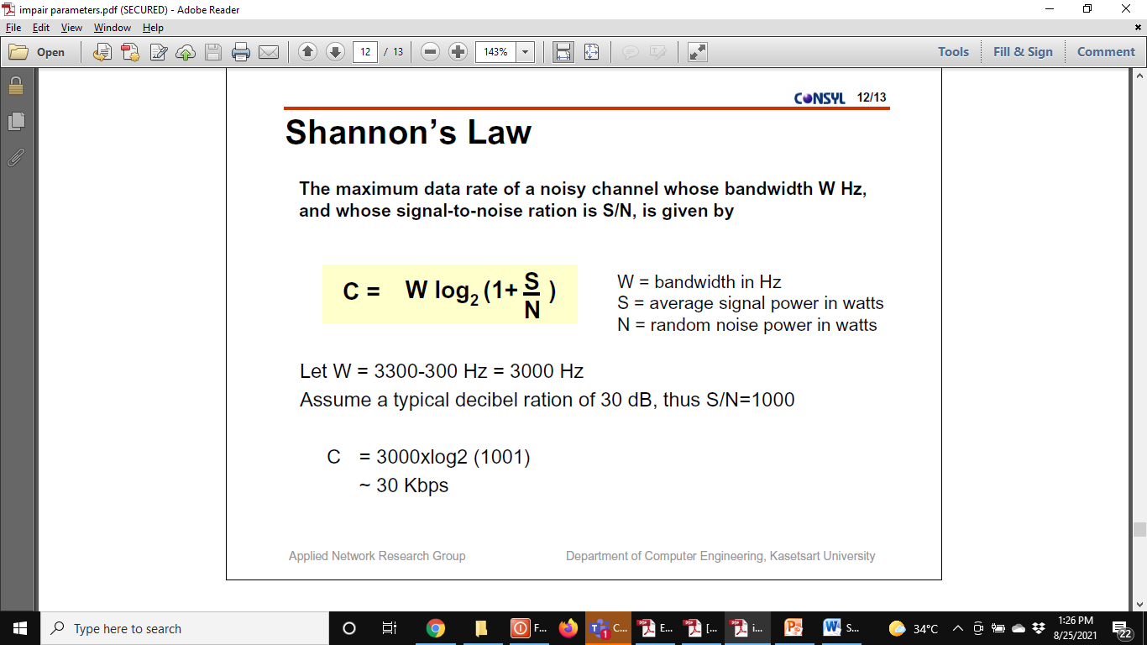

Slide 72
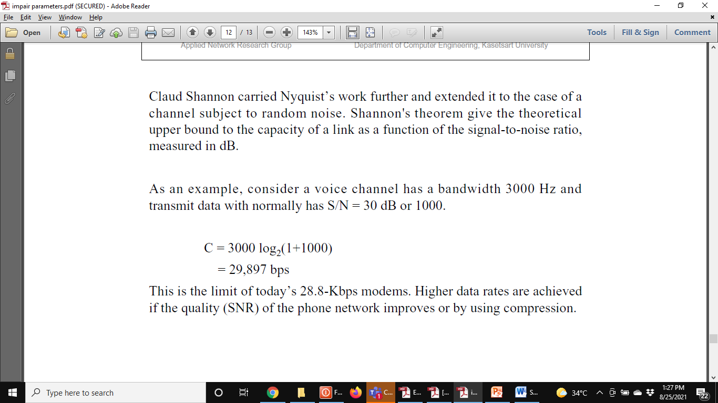

Slide 73
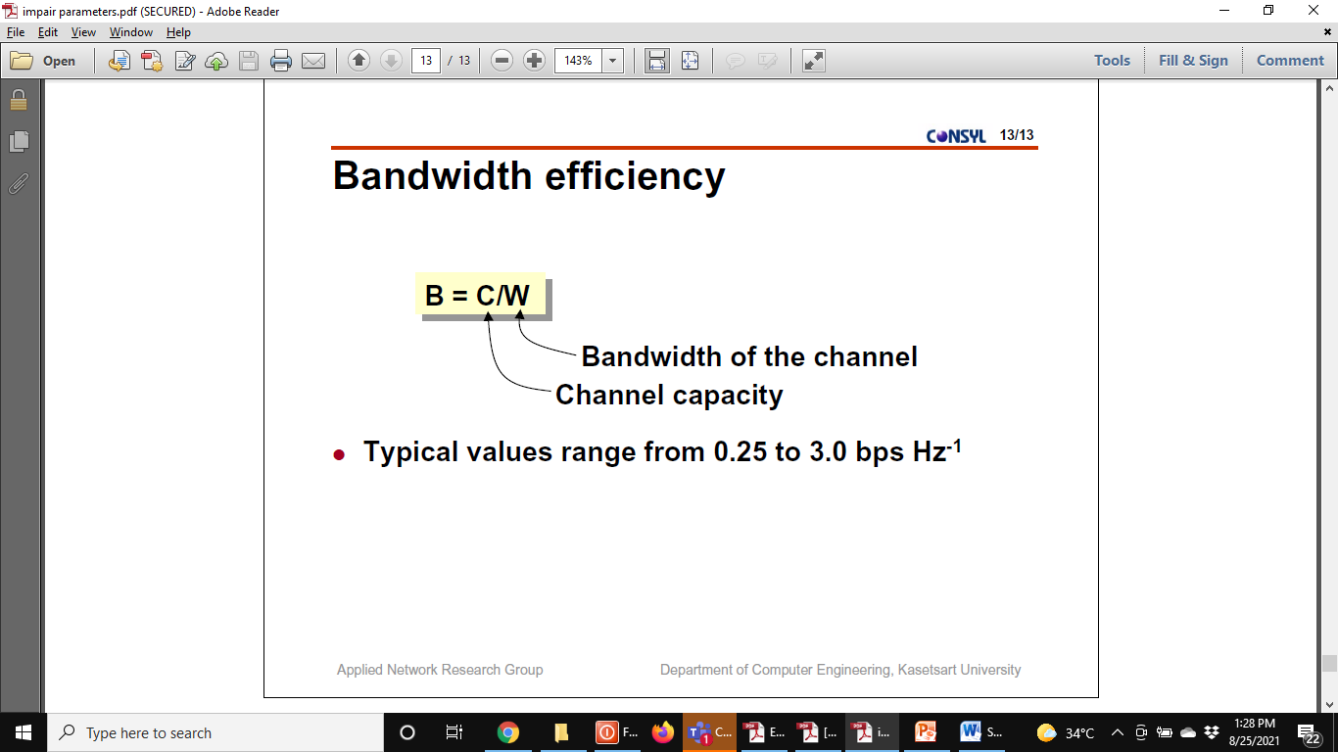

Slide 74
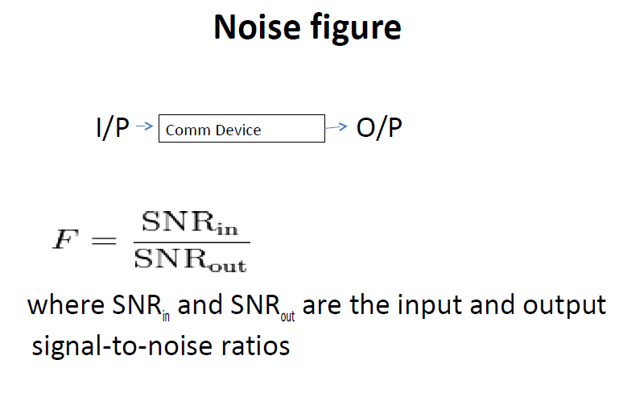

Slide 75
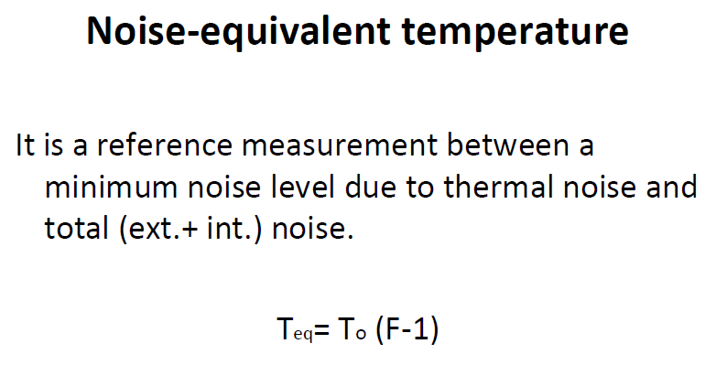

Slide 76
DATA RATE LIMITS
It is very important in data communications that how fast we can send data, in bits per second over a channel.
Data rate depends on three factors:
1. The bandwidth available
2. The level of the signals we use
3. The quality of the channel (the level of noise)
Two theoretical formulas were developed to calculate the data rate: one by Nyquist for a noiseless channel. another by Shannon for a noisy channel.

Slide 77
Noiseless Channel: Nyquist Bit Rate
BitRate = 2 x bandwidth x log₂ L
Where L is the number of signal levels used to represent data, and BitRate is the bit rate in bits per second.
Example: Consider a noiseless channel with a bandwidth of 3000 Hz transmitting a signal with two signal levels. Calculated the maximum bit rate.

Slide 78
BitRate =2 x 3000 x log2 2 =6000 bps

Slide 79
Example 2
We need to send 265 kbps over a noiseless channel with a bandwidth of 20 kHz. How many signallevels do we need?

Slide 80
265,000 =2 X 20,000 X logz L
log2 L =6.625 L =26.625 = 98.7 levels
Since this result is not a power of 2, we need to either increase the number of levels or reduce the bit rate. If we have 128 levels, the bit rate is 280 kbps. If we have 64 levels, the bit rate is 240 kbps.

Slide 81
Noisy Channel: Shannon Capacity
Capacity =bandwidth X log2 (1 +SNR)
A telephone line normally has a bandwidth of 3000 Hz (300 to 3300 Hz) assigned for data communications. The signal-to-noise ratio is usually 3162. For this channel the capacity is calculated as

Slide 82
C =B log2 (1 + SNR) =3000 log2 (l + 3162) =3000 log2 3163
= 3000 x 11.62 = 34,860 bps

Slide 83
PERFORMANCE
Bandwidth
Throughput
Latency (Delay)
Jitter

Slide 84
Bandwidth
Two different measuring values: bandwidth in hertz and bandwidth in bits per second.
Bandwidth in Hertz: Bandwidth in hertz is the range of frequencies contained in a composite signal or the range of frequencies a channel can pass. For example, we can say the bandwidth of a subscriber telephone line is 4 kHz.
Bandwidth in Bits per Seconds: refer to the number of bits per second that a channel, a link, or even a network can transmit. For example, one can say the bandwidth of a Fast Ethernet network (or the links in this network) is a maximum of 100 Mbps.

Slide 85
Throughput
The throughput is a measure of how fast we can actually send data through a network. A link may have a bandwidth of B bps, but we can only send T bps through this link with T always less than B.
In other words, the bandwidth is a potential measurement of a link; the throughput is an actual measurement of how fast we can send data.

Slide 86
A network with bandwidth of 10 Mbps can pass only an average of 12,000 frames per minute with each frame carrying an average of 10,000 bits. What is the throughput of this network?

Slide 87
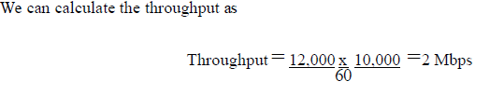

Slide 88
Latency (Delay)
The latency or delay defines how long it takes for an entire message to completely arrive at the destination from the time the first bit is sent out from the source. We can say that latency is made of four components: propagation time, transmission time, queuing time and processing delay.
Latency =propagation time + transmission time + queuing time + processing delay

Slide 89
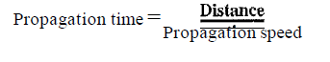
1. Propagation Time: measures the time required for a bit to travel from the source to the destination. The propagation time is calculated by dividing the distance by the propagation speed.

Slide 91
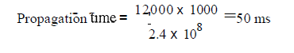

Slide 92
Jitter
Jitter is a problem if different packets of data encounter different delays and the application using the data at the receiver site is time-sensitive (audio and video data, for example).
If the delay for the first packet is 20 ms, for the second is 45 ms, and for the third is 40 ms, then the real-time application that uses the packets endures jitter.

Slide 93
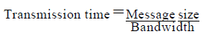
Transmission time
The time required for transmission of a
message depends on the size of the message and the bandwidth of the channel.

